Slide 1

Python
Introduction to Python
Notes:
Hello and welcome to this course of Python from scratch

Slide 2
Key Words
and | del | from | None | TRUE
as | elif | global | nonlocal | try
assert | else | if | not | while
break | except | import | or | with
class | FALSE | in | pass | yield
continue | finally | is | raise
def | for | lambda | return

Slide 3

Designing a Program
Programs must be carefully designed before they are written. During the design process, programmers use tools such as pseudocode and flowcharts to create models of programs.

Slide 4
The Program Development Cycle
Design the Program
Write the Code
Correct Syntax Errors
Test the Program
Correct Logic Errors

Slide 5

Design Process
Understand the task that the program is to perform.
Determine the steps that must be taken to perform the task.
Notes:
The process of designing a program can be summarized in the following two steps:

Slide 6
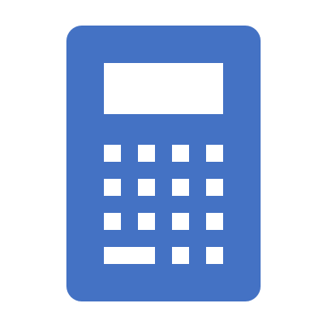
Example
Write a program to calculate and display the gross pay for an hourly paid employee
1. Get the number of hours worked.
2. Get the hourly pay rate.
3. Multiply the number of hours worked by the hourly pay rate.
4. Display the result of the calculation that was performed in step 3.
Notes:
Of course, this algorithm isn’t ready to be executed on the computer.
The steps in this list have to be translated into code. Programmers commonly use two tools to help them accomplish this: pseudocode and flowcharts. Let’s look at each of these in more detail

Slide 7
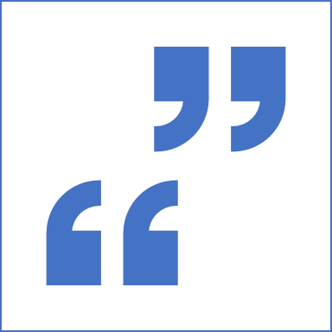
Pseudocode
The word “pseudo” means fake, so pseudocode is fake code.
It is an informal language that has no syntax rules, and is not meant to be compiled or executed.
Programmers use pseudocode to create models, or “mock-ups” of programs
Once a satisfactory design has been created with pseudocode, the pseudocode can be translated directly to actual code.

Slide 8

Flowcharts
A flowchart is a diagram that graphically depicts the steps that take place in a program.
There are three types of symbols in the flowchart:
Ovals
Parallelograms
Rectangle.

Slide 9

Displaying Output
You use the print function to display output in a Python program.
print('Hello world’)
Notice that the quote marks are not displayed when the statement executes. The quote marks simply specify the beginning and the end of the text that you wish to display.
Notes:
Calling function
When you call the print function, you type the word print, followed by a set of parentheses. Inside the parentheses, you type an argument, which is the data that you want displayed on the screen.

Slide 10

Example
write a program that displays your name and address on the computer screen.
print(‘Name’)
print(‘123 Address’)

Slide 11
Strings and String Literals
In programming terms, a sequence of characters that is used as data is called a string
When a string appears in the actual code of a program it is called a string literal
In Python code, string literals must be enclosed in quote marks.
In Python you can enclose string literals in a set of single-quote marks (') or a set of double quote marks (").

Slide 12
Note
If you want a string literal to contain either a single-quote or an apostrophe as part of the string, you can enclose the string literal in double-quote marks.
print("Don't fear!")
print("I'm here!")
Likewise, you can use single-quote marks to enclose a string literal that contains double quotes as part of the string.
print('Your assignment is to read "Hamlet" by tomorrow.’)

Slide 13
Note
Python also allows you to enclose string literals in triple quotes (either """ or '''). Triple quoted strings can contain both single quotes and double quotes as part of the string.
print("""I'm reading "Hamlet" tonight.""")
Triple quotes can also be used to surround multiline strings, something for which single and double quotes cannot be used.
print("""One
Two
Three""")

Slide 14

Checkpoint
Write a statement that displays the following text:
Python's the best!
Write a statement that displays the following text:
The dog can’t say "meow."

Slide 15

Comments
Comments are notes of explanation that document lines or sections of a program. Comments are part of the program, but the Python interpreter ignores them. They are intended for people who may be reading the source code.
In Python you begin a comment with the # character.

Slide 16

Variables
A variable is a name that represents a value stored in the computer’s memory.
Programs use variables to access and manipulate data that is stored in memory.
A variable is a name that represents a value in the computer’s memory.

Slide 17
Creating Variables with Assignment Statements
An assignment statement is written in the following general format:
variable = expression
You use an assignment statement to create a variable and make it reference a piece of data.
age = 25
The equal sign (=) is known as the assignment operator
variable is the name of a variable
expression is a value

Slide 18

Example
# Create two variables: top_speed and distance.
top_speed = 160
distance = 300
# Display the values referenced by the variables.
print('The top speed is')
print(top_speed)
print('The distance traveled is')
print(distance)

Slide 19

WARNING!
You cannot use a variable until you have assigned a value to it
Sometimes a simple typing mistake will cause this error. One example is a misspelled variable name, as shown here:
temperature = 74.5 # Create a variable
print(tempereture) # Error! Misspelled variable name

Slide 20
Variable Naming Rules
You cannot use one of Python’s key words as a variable name.
A variable name cannot contain spaces.
The first character must be one of the letters a through z, A through Z, or an underscore character (_).
Uppercase and lowercase characters are distinct. This means the variable name ItemsOrdered is not the same as itemsordered.

Slide 21
Displaying Multiple Items with the print Function
# This program demonstrates a variable.
room = 503
print('I am staying in room number', room)

Slide 22
Variable Reassignment
Variables are called “variable” because they can reference different values while a program is running.
When you assign a value to a variable, the variable will reference that value until you assign it a different value.
# This program demonstrates variable reassignment.
# Assign a value to the dollars variable.
dollars = 2.75
print('I have', dollars, 'in my account.')
# Reassign dollars so it references
# a different value.
dollars = 99.95
print('But now I have', dollars, 'in my account!')

Slide 23
Global Variables
Variables that are created outside of a function (as in all of the examples above) are known as global variables.
Global variables can be used by everyone, both inside of functions and outside.
x = "awesome" def myfunc(): print("Python is " + x) myfunc()

Slide 24
The global Keyword
Normally, when you create a variable inside a function, that variable is local, and can only be used inside that function.
To create a global variable inside a function, you can use the global keyword.
def myfunc(): global x x = "fantastic" myfunc() print("Python is " + x)

Slide 25
Python Data Types

Slide 26
Built-in Data Types
Variables can store data of different types, and different types can do different things.
Python has the following data types built-in by default, in these categories:
Text Type: str
Numeric Types: int, float, complex
Sequence Types: list, tuple, range
Mapping Type: dict
Set Types: set, frozenset
Boolean Type: bool
Binary Types: bytes, bytearray, memoryview

Slide 27
Getting the Data Type
You can get the data type of any object by using the type() function:
x = 5 print(type(x))

Slide 28
Setting the Data Type
Example | Data Type
x = "Hello World" | str
x = 20 | int
x = 20.5 | float
x = 1j | complex
x = ["apple", "banana", "cherry"] | list
x = ("apple", "banana", "cherry") | tuple
x = range(6) | range
x = {"name" : "John", "age" : 36} | dict
x = {"apple", "banana", "cherry"} | set
x = frozenset({"apple", "banana", "cherry"}) | frozenset
x = True | bool
x = b"Hello" | bytes
x = bytearray(5) | bytearray
x = memoryview(bytes(5)) | memoryview

Slide 29
Setting the Specific Data Type
Example | Data Type
x = str("Hello World") | str
x = int(20) | int
x = float(20.5) | float
x = complex(1j) | complex
x = list(("apple", "banana", "cherry")) | list
x = tuple(("apple", "banana", "cherry")) | tuple
x = range(6) | range
x = dict(name="John", age=36) | dict
x = set(("apple", "banana", "cherry")) | set
x = frozenset(("apple", "banana", "cherry")) | frozenset
x = bool(5) | bool
x = bytes(5) | bytes
x = bytearray(5) | bytearray
x = memoryview(bytes(5)) | memoryview

Slide 30
Python Numbers
There are three numeric types in Python:
int
float
complex
Variables of numeric types are created when you assign a value to them:
x = 1 # int y = 2.8 # float z = 1j # complex
print(type(x)) print(type(y)) print(type(z))

Slide 31
Type Conversion
You can convert from one type to another with the int(), float(), and complex() methods:
x = 1 # int y = 2.8 # float z = 1j # complex #convert from int to float: a = float(x) #convert from float to int: b = int(y) #convert from int to complex: c = complex(x) print(a) print(b) print(c) print(type(a)) print(type(b)) print(type(c))

Slide 32
Random Number
Python does not have a random() function to make a random number, but Python has a built-in module called random that can be used to make random numbers:
import random print(random.randrange(1,10))
Import the random module, and display a random number between 1 and 9:

